Slide 1
Generating childlike images of adults using Generative Adversarial Models.
Submitted by
Varun SA(2148059) & Kartikay Agrawal(2148064)
2 Master of Science (Data Science),
Department of Computer Science

Slide 2
Outline
Introduction
Need for Study
Dataset
Related Works
Methodology
Advantages of proposed solution
Limitations of Existing Work
Conclusions
Bibliography

Slide 3
Introduction
You might not think that programmers are artists, but programming is an extremely creative profession. It’s logic-based creativity. - John Romero
There was a time when we could get our personal images only via a photobooth. Many people didn’t get the luxury to get their photos clicked. But now with the evolution of technology over the years,it has now become possible to generate our own past images from our current images.
With continuos advancements over time,Generative Modelling has taken a big leap especially in the field of fake image Generation.Many different kind of architectures have been developed over the years for performing different tasks such as Image,Text,Music,and Game Generation.

Slide 4
Some of these architectures include:
2014->VAE,Encoder-Decoder,GAN,Attention
2015->U-Net,Neural Style,Resnet
2016->pix2pix
2017->WGAN,CycleGAN,Transformers,ProgressiveGAN
2018->World Models,SAGAN,BigGAN,BERT
2019->StyleGAN,GPT-2,MuseNet
2020->WaveGAN,GAN 356 M
2021->GPT3
The most recent groundbreaking advancements in Generative Modelling:
StyleGAN by NIVIDIA :Hyper-realistic images of human faces
GPT-3 :Language Model by OpenAI

Slide 5
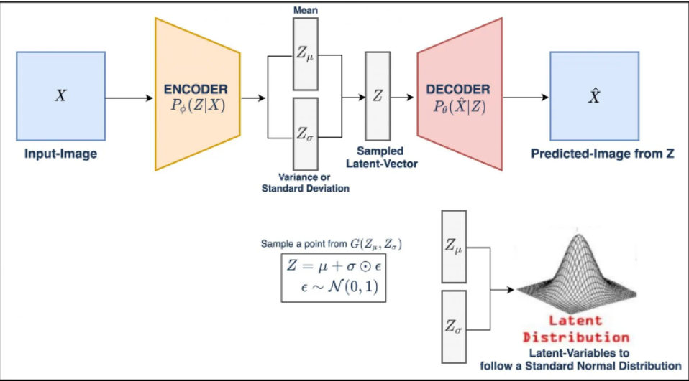
1)Variational Autoencoders
VAEs are one of the first major break throughs in the field of image generation.Initially images were being generated by probabilistic models i.e. by using Naive Bayes but the image quality was very poor.[6]
VAEs comprises of:
Encoder: high dimensional input is converted to a lower dimensional representation vector.
Decoder: decompresses a given representation to the original domain.
To the already existing loss for Autoencoders an extra loss is added which ensures the images are generated at the centre and if they’re not then they are penalised accordingly.
The extra loss used i.e. the KL Divergence ensures that the encoder maps the images onto a latent space according to a multivariate normal distribution.

Slide 6
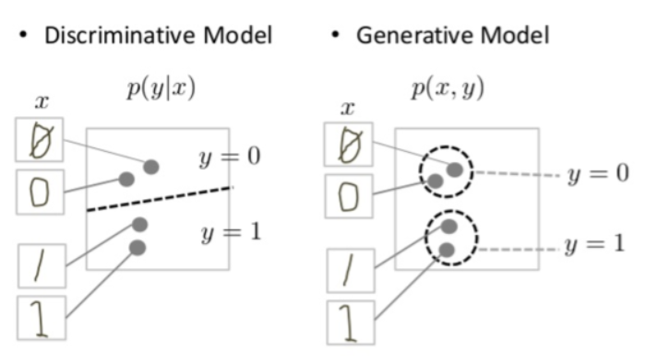
2) Traditional GANs[3]
The Gan architecture majorly comprised two components called generator and discriminator. Generator learns and produces fake images where on the other side the discriminator tries to discriminate the images produced as fake or real. Likewise at one stage the model will be able to generate images just as the real one. Using this method we can recreate the individual’s younger image.
Generator in a GAN learns to create fake data by incorporating feedback from the discriminator. It learns to make the discriminator classify its output as real.[1]
Discriminator in a GAN is simply a classifier. It tries to distinguish real data from the data created by the generator. It could use any network architecture appropriate to the type of data it's classifying.[1]

Slide 7
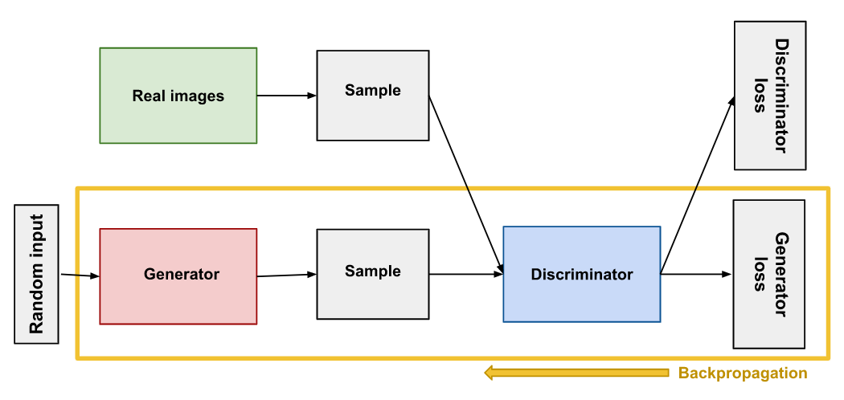
GAN Backpropagation

Slide 8
Need for Study
# Images of younger self are something to be nostalgic about. Parents store their child’s photos in their albums and cherish all those little moments for life to live them again.
These photos provides them with a chance to cherish the delightful memories of one's own self and brings back those days back to life.
# In this era of Google Photos, we've created a model which will help us create images for older generations who didn’t get the privilege to get their photos clicked and store them for their memory lane.
# This model can be beneficial for finding missing people who may have been missing for years by altering their facial features and generating their images of how they might be looking it the present time.
# This model can be extremely beneficial for studying changes in human features with time and their anatomical pattern and behaviour.

Slide 9
Dataset
Since the GAN Models require a huge dataset for training, on searching we were able to find the most widely used/ popular face related datasets.
Some of them include:
1)Faces:Age Detection Dataset
Description about the dataset
The dataset has three labels
2)UTKFace Dataset
The UTKFace dataset is a large-scale face dataset with long age span (range from 0 to 116 years old). The dataset consists of over 20,000 face images with annotations of age, gender, and ethnicity. The images cover large variation in pose, facial expression, illumination, occlusion, resolution, etc. [2]
3)FamilyGan
The dataset is already pre-processed and scaled and is ready to use.
4)Facebook’s 10 Year old Challenge Dataset
Selected dataset
Dataset containing images of old men and women and young adults.

Slide 10
Related Works
Since the development of GAN model, researchers have been working on various different kinds of models based on the use case. Some of the most famous models which can be found are:
FamilyGan:
A FamilyGAN Model is capable of generating a Child's Face using both his/her parent’s photos. The model is found to be creating accurate baby images using features from both parents for example eyes.
Age Estimation on UTKFace[2]:
On a very famous Kaggle dataset used for competitions i.e. UTKFace researchers have developed a model which is capable of predicting ages of people based on their features .The model used in this dataset is FA-GAN.
Generative Adversarial Style Transfer Networks for Face Aging[7] :
This model is predicting future older images of an individual based on their current facial features and generic features of old people.

Slide 11
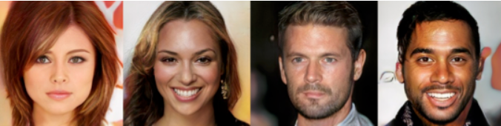
Methodology
GANs are highly time intrinsic models. High GPUs are required to train such models. Thus, These models are always trained in batches(taken as 128 in our model).
StyleGAN by NVIDIA
Although there are many diverse kinds of models generated by different kinds of equations and flowcharts for generation of facial features,StyleGAN developed by NVIDIA is one of the most popular GAN models being used for generating hyper-realistic images of human faces.

Slide 12
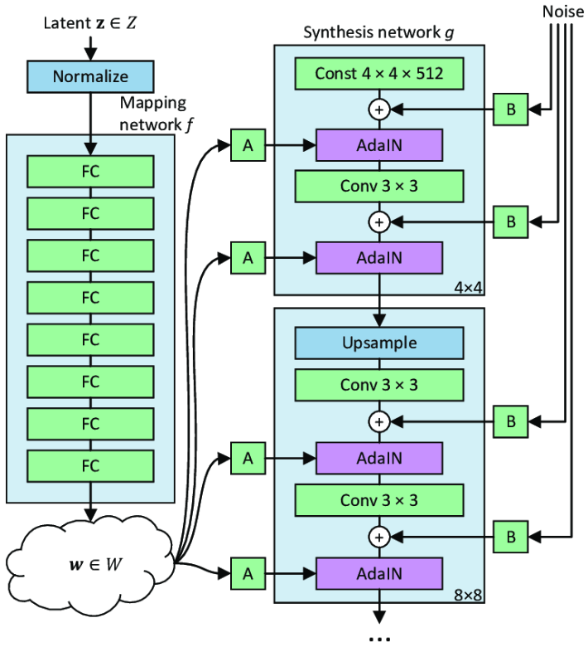
Since the latent vector after passing through 8 Fully Connected is being given as input to all the layers along with some Gaussian Noise, The images is able to detect features in the model more accurately and precisely.
The GAN model for younger image generation is created using the following steps :
Step-1:Importing Dataset and required libraries
Step-2:Building a user-defined Generator and Discriminator
Step-3:Combining both the user-defined functions to train a GAN model. We train the model with approximately 20k images
Step-4: we generate images using trained model
Step-5: we do the arithmetic operation on facial features and get the required result as the output.

Slide 13
Advantages of proposed solution
The model is able to detect facial features of an individual and is capable of replicating features based on Ethnicity, Race and Gender.
StyleGAN Model has better architecture than conventional GAN. This will increase the accuracy because it grants control over the characteristic of the generated image as it is upsampling(For the generator) and then downsampling(For the critic) with the help of an added noise.

Slide 14
Limitations of Existing Work
Since we can’t find datasets of people with their young images in the 90s,and also training images of different individuals is highly correlated to their Ethnicity,Race,Gender etc. [5]The existing models are not being able to predict such features very accurately.
There is not much work or implementation of GAN to generate young images of individuals, Since the process is highly time intrinsic and training such features require several hours of training which isn’t feasible so people prefer using some pretrained models which have been developed and are providing fairly decent younger images.
For some ages some model is performing better, for other age groups some other model is performing better. We are not able to find any model which is overall providing good results for all the possible ages due to it’s non-linear behaviour in facial features as models are only able to identify some specific features only for some specified age .

Slide 15
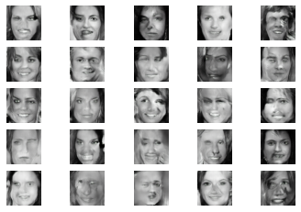
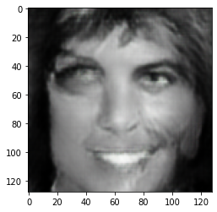
Conclusion
Our trained model has generated images where we can clearly notice that out of five trained models, a model with 20k images trained with 30 epochs has given better quality images than the other model that are trained. We have trained five models, one with 2000 images with 100 epoch, 2000 images with 250 epoch, 20000 images with10 epoch, 20000 images with 20 epoch and 20000 images with 30 epoch.
We could get faces from the generated images. Now, we have identified images with young individuals, neutral faces and old individuals. We have done the arithmetic, young image - neutral image + old image. And generated the required result.
Though the resultant image does not fully achieve the accuracy/precision, we can see that we have partially achieved the end goal. To get a better result we have to train the model with more epochs. This takes a lot of computational time and can't be achieved through the resources we have now while doing the project considering time limits and Computational limits. We will continue to explore more about GAN and its uses in the future to come.
Images generated by trained model with 20k images and 30 epoch
Generated young image from the old image

Slide 16
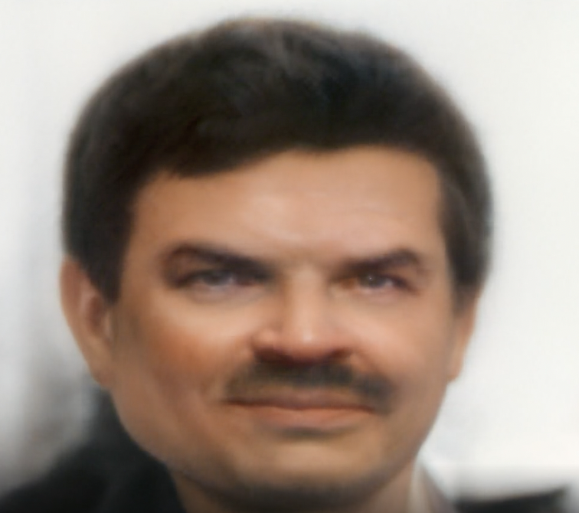
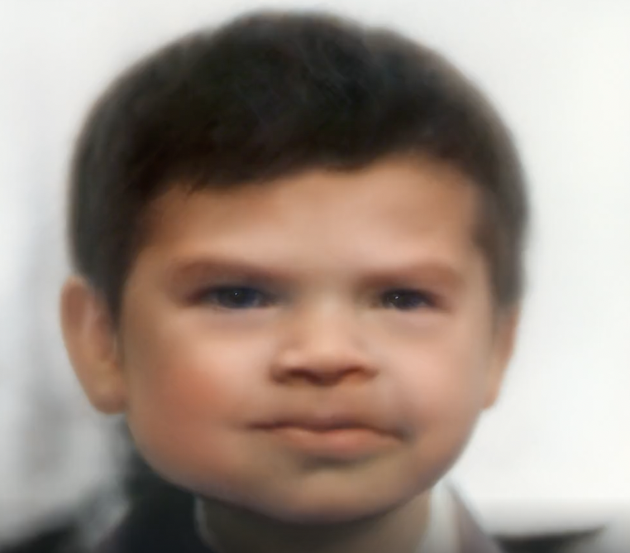
We have also tested a pre trained model and got the desired result. This is to check and assure that we can build a better model and there is a scope for betterment and research in this area.
Old image - input
Young image generated from the old image - output

Slide 17
Bibliography
[1] Google Developers. 2022. The Generator | Generative Adversarial Networks | Google Developers. [online] Available at: <https://developers.google.com/machine-learning/gan/generator>
[2] Paperswithcode.com. n.d. Papers with Code - UTKFace Dataset. [online] Available at: <https://paperswithcode.com/dataset/utkface> [Accessed 1 May 2022].
[3] I. Goodfellow et al., “Generative adversarial networks,” Commun. ACM, vol. 63, no. 11, pp. 139–144, 2020, doi: 10.1145/3422622
[4] researchgate. 2021. Differences in Neural Activity and Location Correlated with Viewing Threatening or Attractive Images of Individuals of the Same or Different Sex and Race. [online] Available at: <https://www.researchgate.net/publication/335970023_Differences_in_Neural_Activity_and_Location_Correlated_with_Viewing_Threatening_or_Attractive_Images_of_Individuals_of_the_Same_or_Different_Sex_and_Race.>
[5] 2021. Reinforce NIDS Using GAN to Detect U2R and R2L Attacks. [online] Available at: <https://link.springer.com/chapter/10.1007/978-981-16-3675-2_27> [Accessed 1 May 2022].
[6] Kingma, D. P. and Welling, M. (2014). Auto-encoding variational bayes. In Proceedings of the International Conference on Learning Representations (ICLR).
[7] S. Palsson, E. Agustsson, R. Timofte, and L. Van Gool, “Generative adversarial style transfer networks for face aging,” IEEE Comput. Soc. Conf. Comput. Vis. Pattern Recognit. Work., vol. 2018-June, pp. 2165–2173, 2018, doi: 10.1109/CVPRW.2018.00282.

